Slide 1
FINAL PROJECT
House Pricing Prediction
Prepared by
Aydin Gokcen
Buck Matt
Channer Timothy
Le Phuong
Russo Estel

Slide 2
Agenda
Project Overview
Data Exploration & Cleaning
Analysis Phase
Results of the Analysis
Recommendations
This Photo by Unknown Author is licensed under CC BY-SA-NC

Slide 3

Overview of the Project
Create a machine learning (ML) model that can predict house prices in Ames City, IA, USA, for sellers and provide data visualization, via Tableau, in order to picture the outputs from the ML model.
Notes:
Create a machine learning model that can predict house prices in Ames City, IA, USA, for sellers and provide an interactive display for the users, where users can filter for various search criteria simultaneously.

Slide 4
Project Plan
Segment 1
Project Topic Decision
Data Exploration
Segment 2
Data Cleaning
Machine Learning Model Creation and Performance
Segment 3
Visualization of Predicted Values from Machine Learning Model
Conclusion
Data Acquisition
Machine Learning Model Result Analysis
Database Creation
Lessons Learned (Individual Self-Assessment)
Project Management

Slide 5
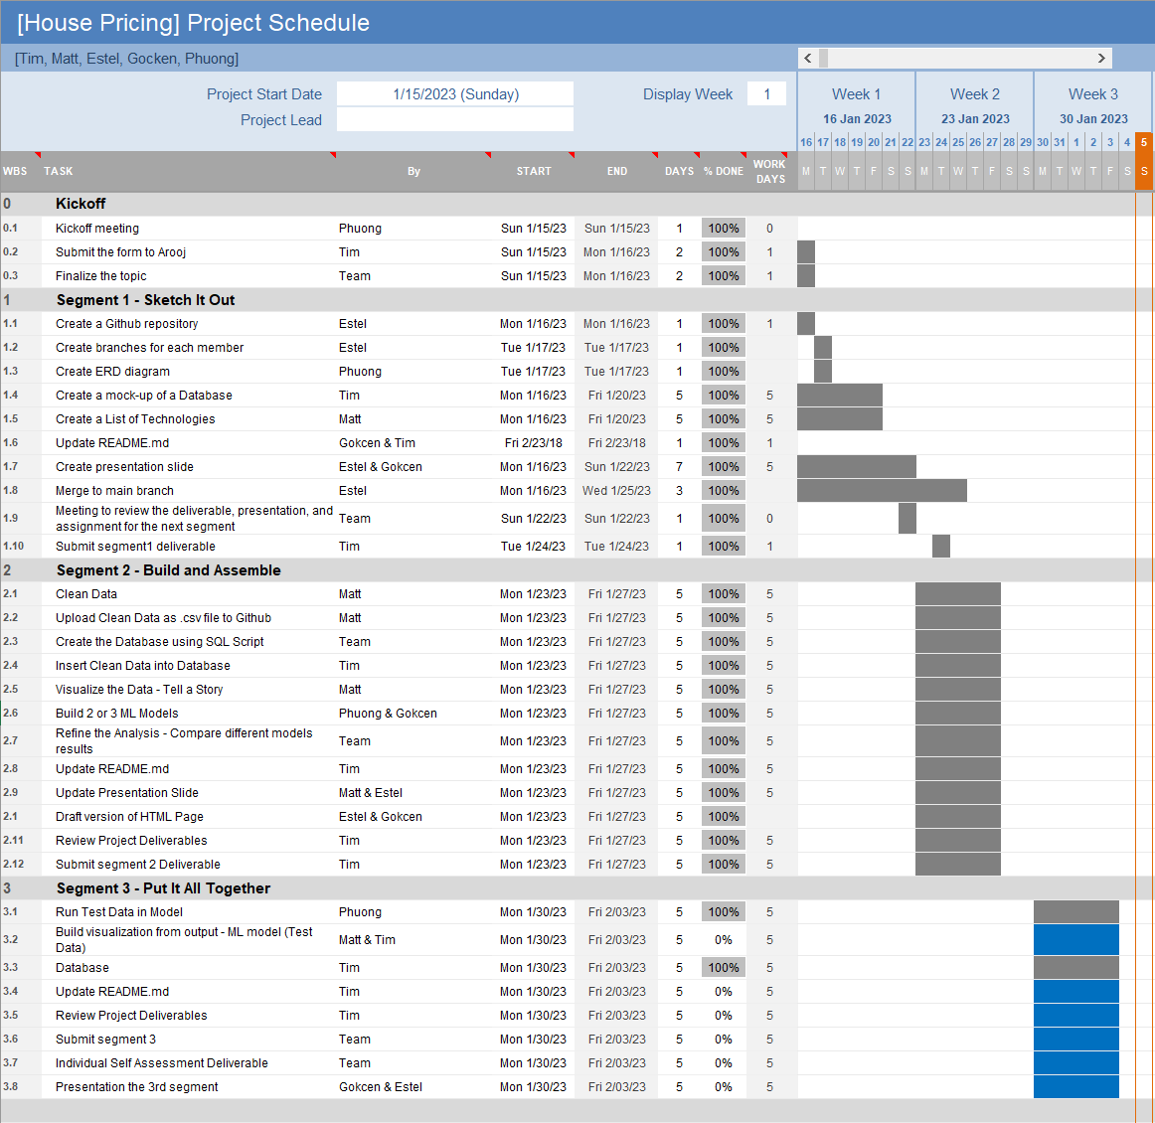
The Plan
Allowed for task delegation
Aided in time management
Ensured quality assurance remained constant
Used Slack to communicate ideas, and weekly meetings

Slide 6

Why was This Topic Chosen?
Many homeowners look to sell their homes.
Using our visualization, users will be able to pinpoint what key factors need to be taken into consideration to maximize the sale of their home.
This model can be adapted to any country, and city, in the world.

Slide 7

What Answers Are We Looking For
Best time of the year to sell?
What neighborhood has higher sale prices?
How does the age of the house (Year built) affect the sale price of a home?
Notes:
So we are looking for some answers.
First, What is the best time of the year to sell a house?
Second, What neighbourhood has higher sale prices?
And last but not least,
How does the age of the house affects its price.

Slide 8
Technologies Used in the Project
Cleaning, Preparing and Exploring
_{the Data}
_{Training}
_{and Executing Machine Learning}
_{Model}
_{Visualization}
DataBase
Excel
Jupyter Notebook
Pandas
Numpy
Matplotlib
ML -
One Hot Encoder, Rare Label Encode,
Random Forest Regressor, Joblib
Tableau
PostgreSQL
ERD

Slide 9

Data Description
The original data was retrieved from Kaggle.
A competition on predicting sales prices.
Composed of 81 columns and 1460 rows.
Filtered down to 18 columns and 1150 rows.
This Photo by Unknown Author is licensed under CC BY-SA-NC
Notes:
In Kaggle there is a competition on predicting sales prices.
They are describing almost every aspect of residential homes in Ames Iowa. Even though we did not compete we used their data for our project.
That original data had 81 columns and 1460 rows. We have cleaned it and we’ll explain the cleaning procedure later on.
We filtered down that data to 18 columns and 1150 rows.

Slide 10

Data Cleaning & Exploration
Subjective
Null Values
Data Transformation
Data Merging
Notes:
Subjective
Various columns were given ratings for the state of a certain property of the house, either as a 1-10, or an ordinal rating from poor to excellent. As methodical the rating system may be, the actual category itself can be put up to debate depending on who one asks. An example from the original dataset is a column named ‘HeatingQC’ (Heating quality and condition) where it rates the quality of heating, and its condition, from poor to excellent. What was noted that people react differently to heat. For some what could be considered average, or typical, could be someone else’s excellent. For this reason, various other columns that were categorized as subjective were dropped from the dataset.
Null Values
An inherent part of any dataset, whether large or small, is the eventuality of missing data - a null value, or a blank cell. This dataset was no different. Using the ‘df.isnull()’ function, columns with null values were identified and further looked into. Depending on the row, the purpose of the null value was inspected. For example, in the case of column ‘GarageType”, where 72 null values were found, it was noted that the null values did not mean that the dataset was missing information, but rather the null values represented the lack of a garage. Therefore, these values were converted to ‘NoGar’ to show that there is no garage. Another example would be column ‘FullBath’ where, for some reason, there are houses without full bathrooms. Rows with ‘0’, as their ‘FullBath’ value, were removed from the dataset.
Data Transformation
Some of the columns had integer types of data to represent the corresponding part of the house, such as the square footage of the pool (PoolArea), or the number of fireplaces (Fireplaces). When the decision came to whether drop, or not, these columns. Ultimately, the team decided that it would be nice for one to look for these features, should they be available. Once it was determined the columns would stay in the dataset, it begged the question: How would they be represented? The answer came down to converting the numeric values to Booleans. If the ‘PoolArea’ was greater than zero, then the house has a pool. Otherwise, if the value was zero then the house has no pool. The same approach was taken with the ‘Fireplaces’ where if the count of fireplaces was 0, then there were no fireplaces, and if the value was greater than zero, the house does have at least one fireplace.
Another case of data transformation was the ‘MoSold’ and ‘YrSold’, as they were represented by two integer values. It became apparent that a data transformation was required when attempting to import the dataset when the DATE data format in PostreSQL required the ‘DateSold’ to be in YYYY-MM-DD, rather than YY. Two new columns were created: ‘DaySold’, which was given an arbitrary value of ‘01’, rather than ‘30’ or ‘31’, as not all months share these days. Secondly, ‘DateSold’, that utilized the RIGHT, MID, and LEFT functions in Microsoft Excel, and referenced the respective year, month and day, sold columns. Lastly, the ‘DateSold’ column was categorized as a ‘Date’ column within excel with a custom format that would meet the expectations of PostreSQL.
Merging Information
Initially, the ‘Neighborhood’ names were shortened to facilitate reading, such as ‘BrkSide’ being ‘Brookside’. Using the ‘data_description.txt’ a table was created with the purpose of merging it with the dataset in order to drop the abbreviated neighborhood column and replacing it with a new column that has the full names.

Slide 11
Data Description The Variables
Lot Area (Lot size in square feet)
Lot Shape (General shape of property)
Neighbourhood (Physical locations within Ames city limits)
Building Type (Type of dwelling)
Year Built (Original construction date)
Year Remodeled (Same date as construction date if no remodeling or additions)
Heating Type (Type of heating)
Total House Square Feet (Total area of the house in square feet)
Number of Full Bathrooms (Full bathrooms above grade)
Number of Half Bathrooms (Half baths above grade)
Number of Bedrooms above ground floor (Does NOT include basement bedrooms)
Fireplaces (Yes/No)
Garage Type (Garage location)
Garage Cars (Size of garage in car capacity)
Paved Drive (Paved driveway)
Pool (Yes/No)
Year Sold (YYYY-MM-DD)
Sale Price

Slide 12
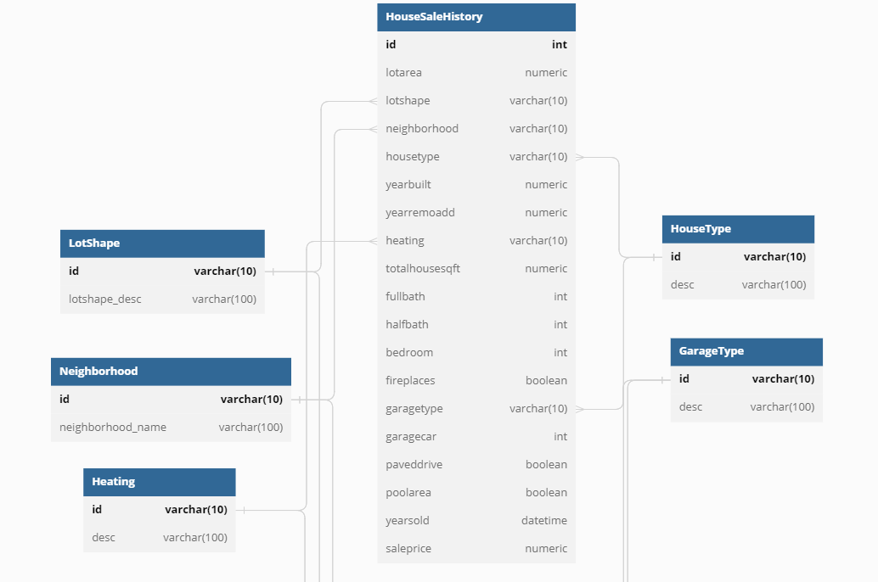
The Database Schema
Notes:
House Type: The list of types of houses
Garage Type: A list of types of garages
Neighbourhood: A list of neighborhoods in the City of Ames
Lot shape: A list of lot
Heating: A list of types of heating such as steam heat
House Sale History: A table includes house sales transactions in the City of Ames.

Slide 13
Machine Learning Model
Choose appropriate models
Train models
The best model
Evaluate performance
Notes:
Why choose MLR?
Plan to improve performance?
What do the results show?
What can be concluded?

Slide 14
Machine Learning Model
Random Forest
Multiple Linear Regression
Gradient Boosting
Neural Network
Notes:
Why choose MLR?
Plan to improve performance?
What do the results show?
What can be concluded?

Slide 15
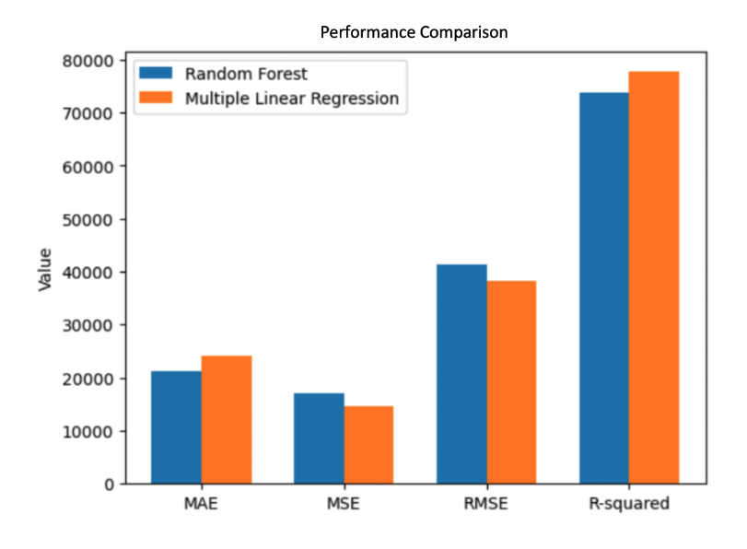
Performance Comparison of 2 Models
Notes:
Both the MSE and RMSE were lower in the Linear Regression model than the Random Forest model. Making the Linear Regression model more suitable for predicting the house sale values.
The MAE was lower in the Random Forest model than the Linear Regression hence making the Random Forest model more suitable for predicting the house sale values.
The R-Squared was higher in the Linear Regression model than the Random Forest model. Therefore, the Linear Regression model is more suitable for predicting the house sale values.
In conclusion, out of the four different scores, three sided with the Linear Regression model being the most apt model to use for further work.

Slide 16
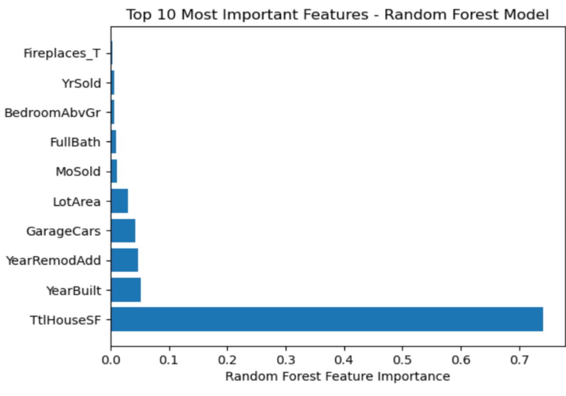
Top 10 Most Important Features
Notes:
Which features of the houses affect the sale prices in Ames City, USA.

Slide 17
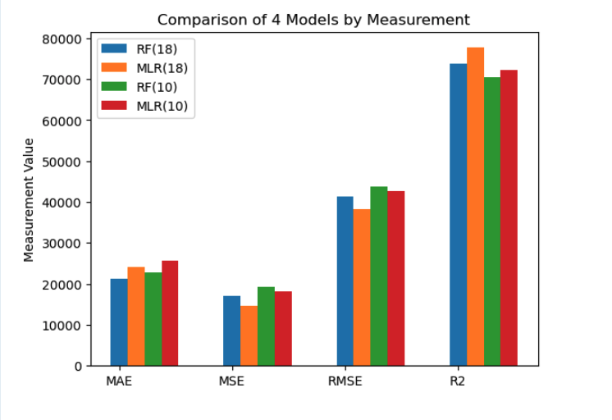
Refining The Model
Notes:
The lower MAE means a better fit for the model, so between the models running the 18 variables, the linear regression model is the one with the best fit. Furthermore, between the models working with the top ten features, the random forest model has a better fit.
The relationship with the MSE is the same as the MAE. The lower the score the better. In the case of the 18 variable models, the linear regression has a better fit. For the models running the top ten variables the random forest model has a better fit.
Based on the results for the RMSE, the model which has a better fit, for 18 variables, is the linear regression model, and the model most appropriate for running the top ten features is the random forest.
Based on the results of the R-Squared test, where a higher score determines the better fit, it can be noted that the random forest model works best for the 18 variables. However, for the models running the top ten features the linear regression model is more appropriate.

Slide 18
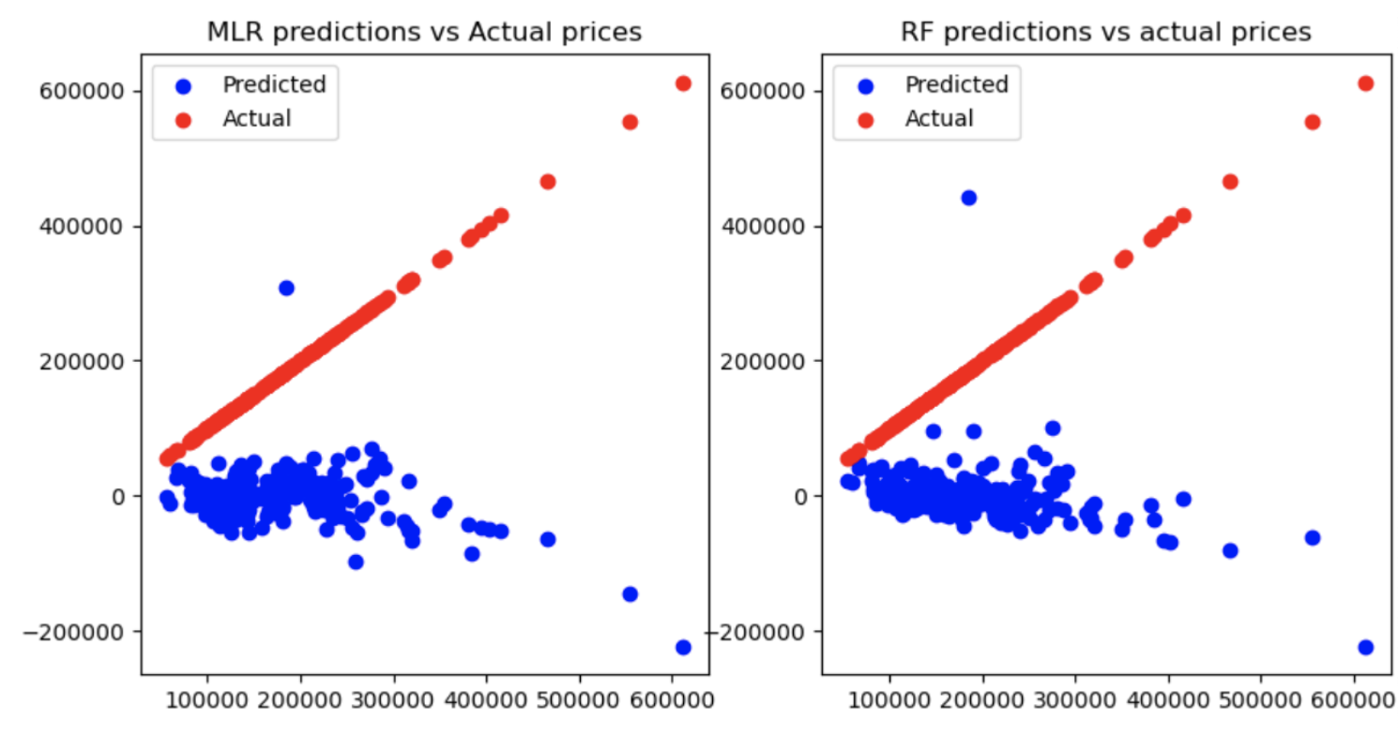
Visualization of Predicted Values Vs. Actual Values

Slide 19
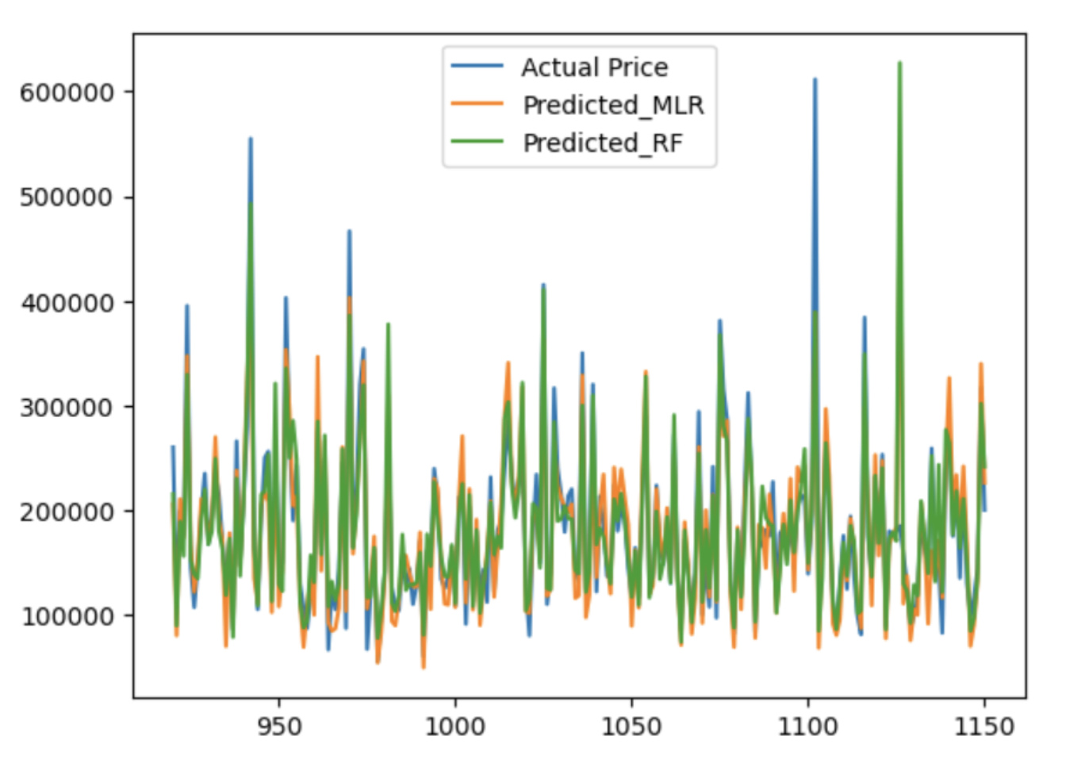
Visualization of Predicted Values Vs. Actual Values

Slide 20
Conclusion of Comparison
For running the model with the original 18 variables submitted, it is recommended to use the linear regression model, as it outperformed the random forest model in three out of four tests, with an accuracy score of 77%.
On the other hand, for the model running the top ten variables, it is recommended to use the linear regression model, as it outperformed the random forest model in three out of four tests.

Slide 21
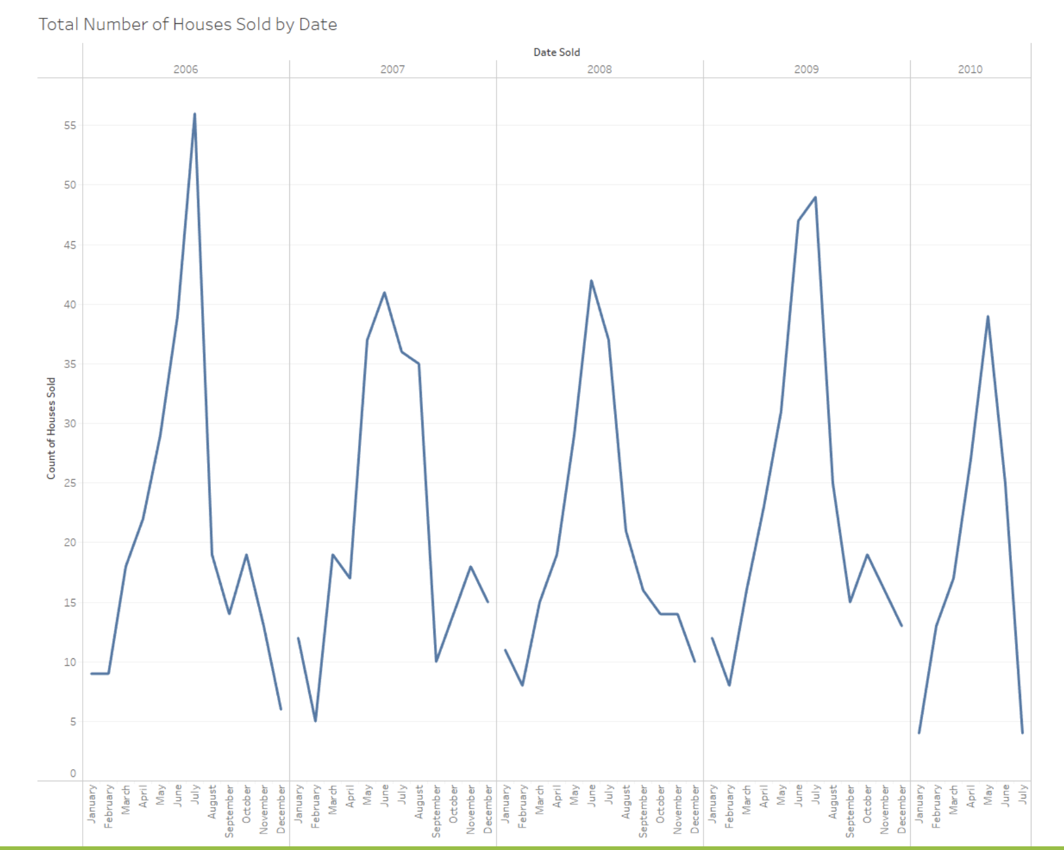
Results of Analysis Best time of the year to sell?

Slide 22
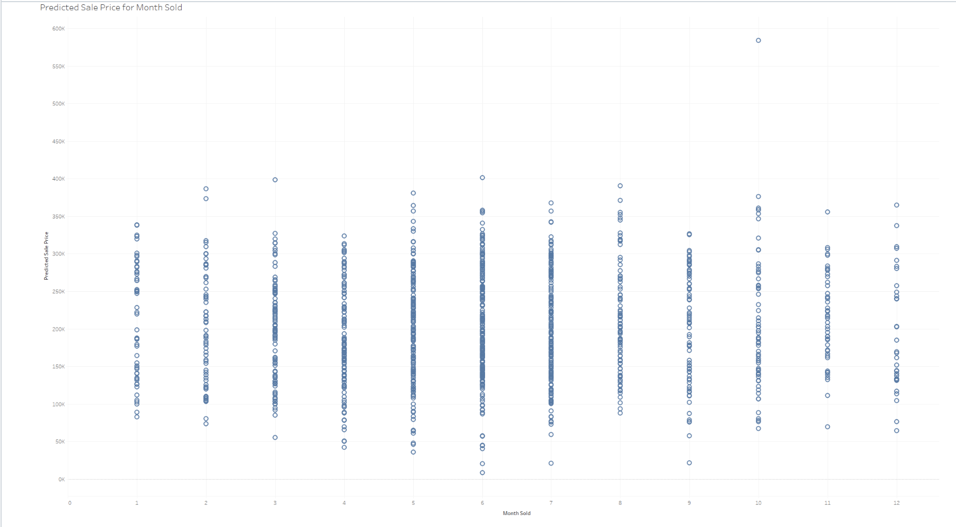
Results of Analysis Best time of the year to sell?

Slide 23
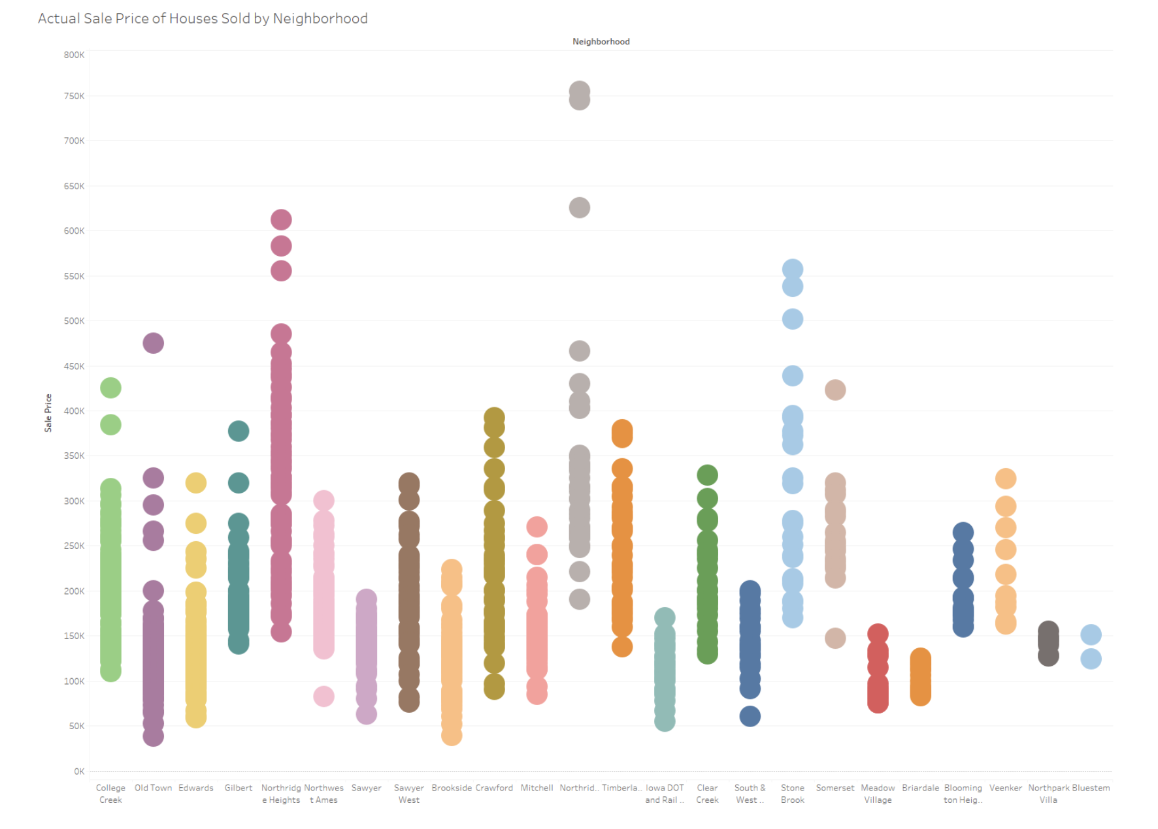
Results of Analysis What neighborhood has higher sale prices?

Slide 24
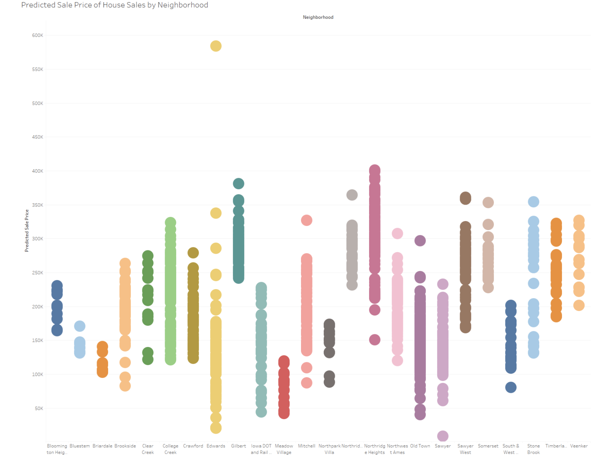
Results of Analysis What neighborhood has higher sale prices?

Slide 25
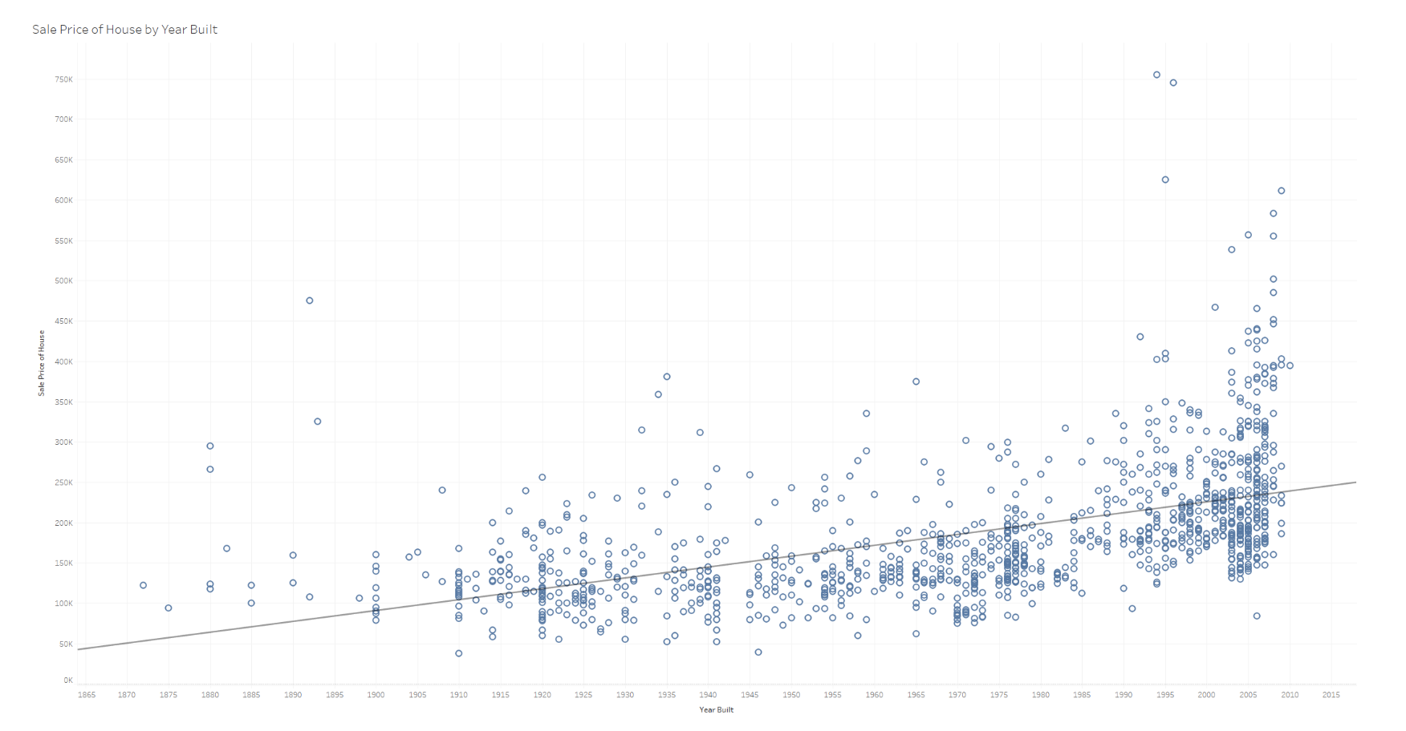
Results of Analysis How does the age of the house (Year built) affect the sale price of a home?

Slide 26
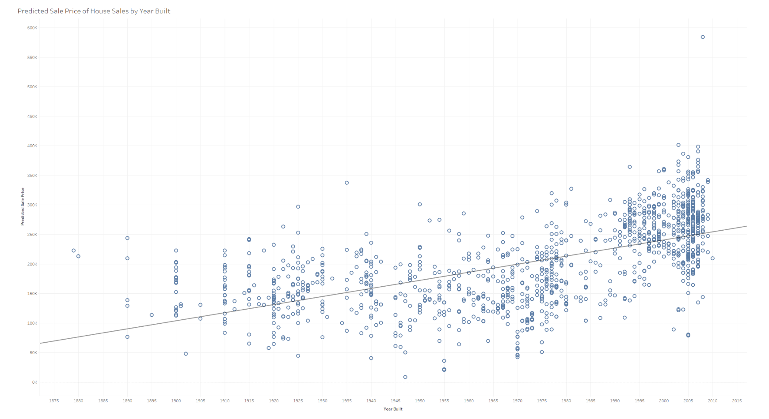
Results of Analysis How does the age of the house (Year built) affect the sale price of a home?

Slide 27
Recommendations
Recommendations for Future Analysis:
Gradient Boosting for model performance enhancement.
More models to be able to compare and determine the best results.
Different data from other cities/countries to verify the ML model’s capacity.
If given more time, what we would have liked to do:
HTML Page to provide the user with a sense of interactivity that permits simultaneous filtering of various house features.
House Sale Prediction table.
Geocoding the neighborhoods for the visualization portion.

Slide 28


